Slide 1
Pls 2000 power & politics dr. shannon
Freedom, Justice & Order

Slide 2
Justice, order, freedom
I. THE PURPOSE OF GOVERNMENT
II. ORDER
III. FREEDOM
IV. JUSTICE
TERMS TO KNOW
Four Freedoms Hobbes
John Stuart Mill Harm Principle
Original Position Veil of Ignorance
Locke Charlie Hebdo

Slide 3
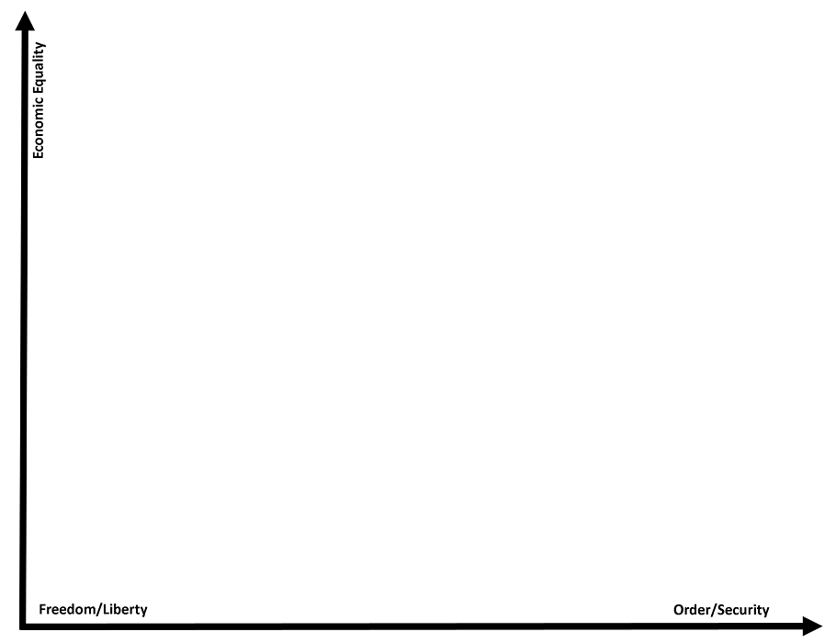
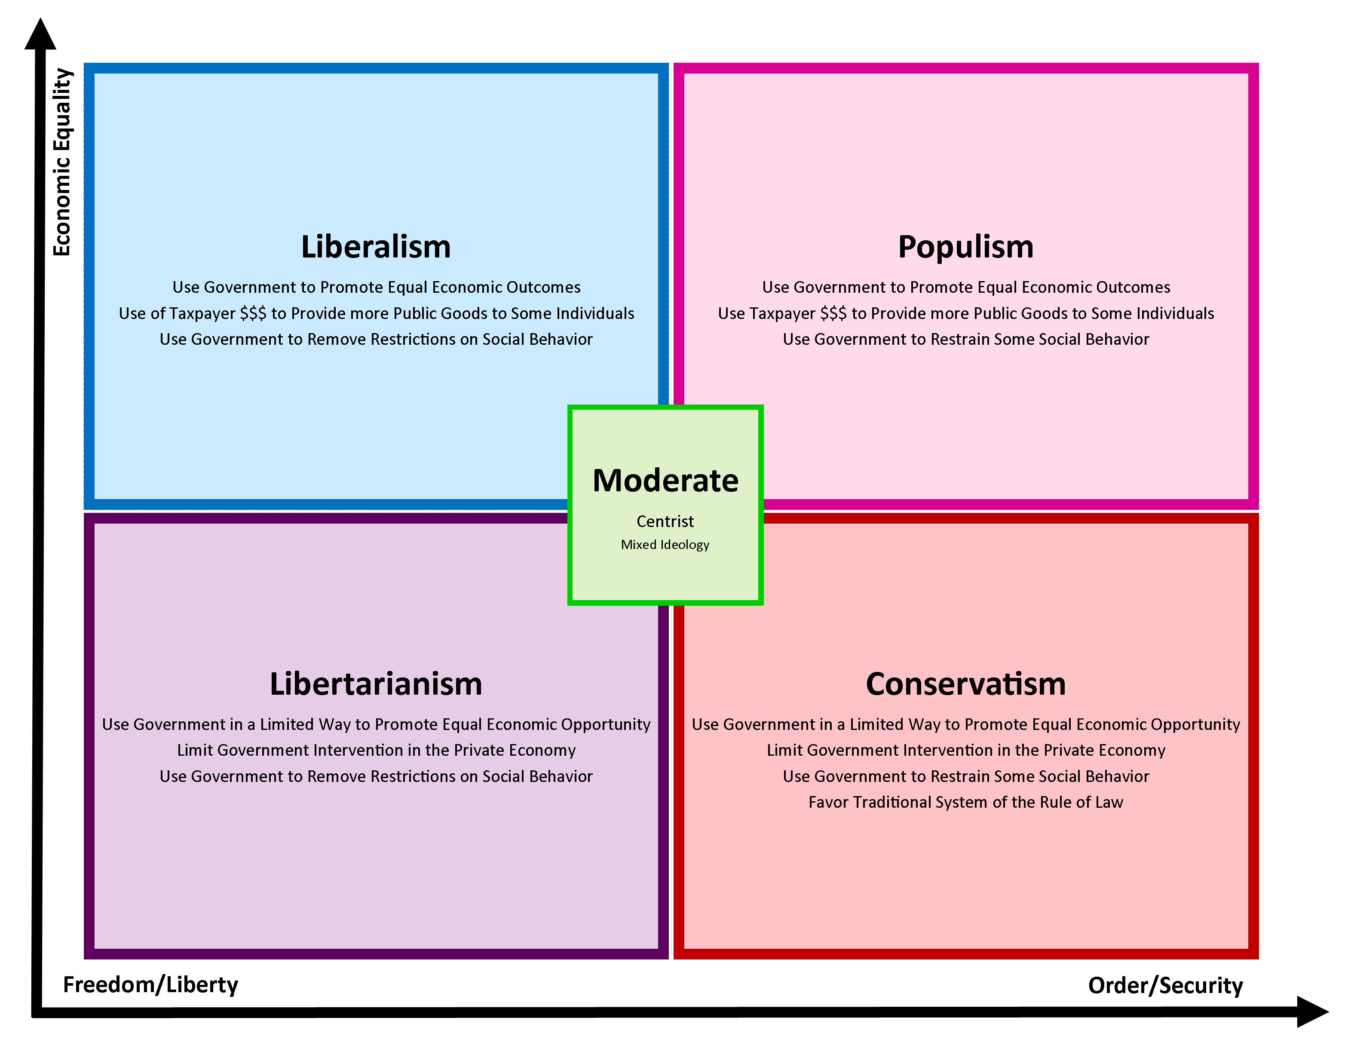
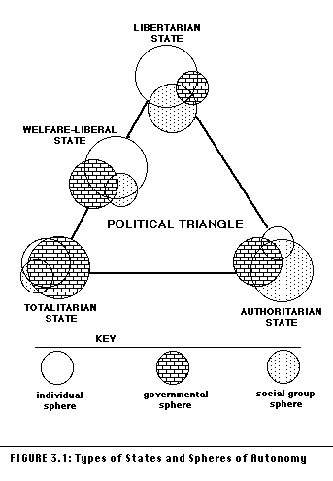
I. THE PURPOSE(S) OF GOVERNMENT
Order
Freedom
Justice

Slide 4
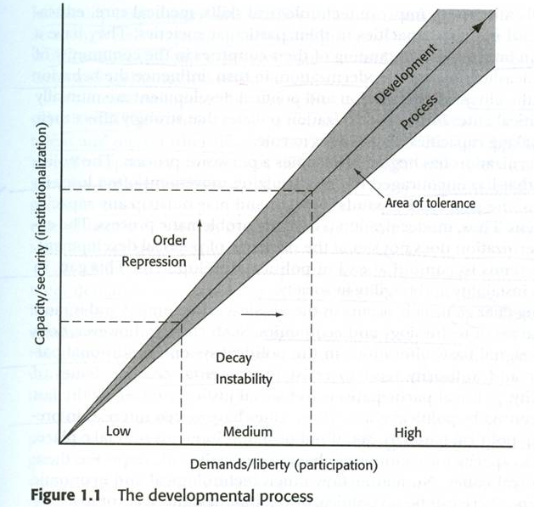
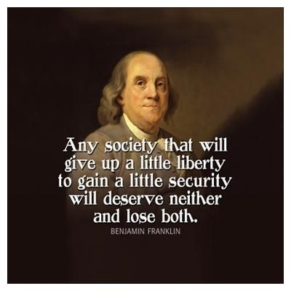
Ii. order
Maintain rule of law and security of life and property
Social Contract (Hobbes): without order, none of the rest possible
People forfeit some freedom for political order
Social Contract (Locke): unlimited government is abusive; government should be limited by, from and for the people
Too much order (tyranny) = right to rebel

Slide 5
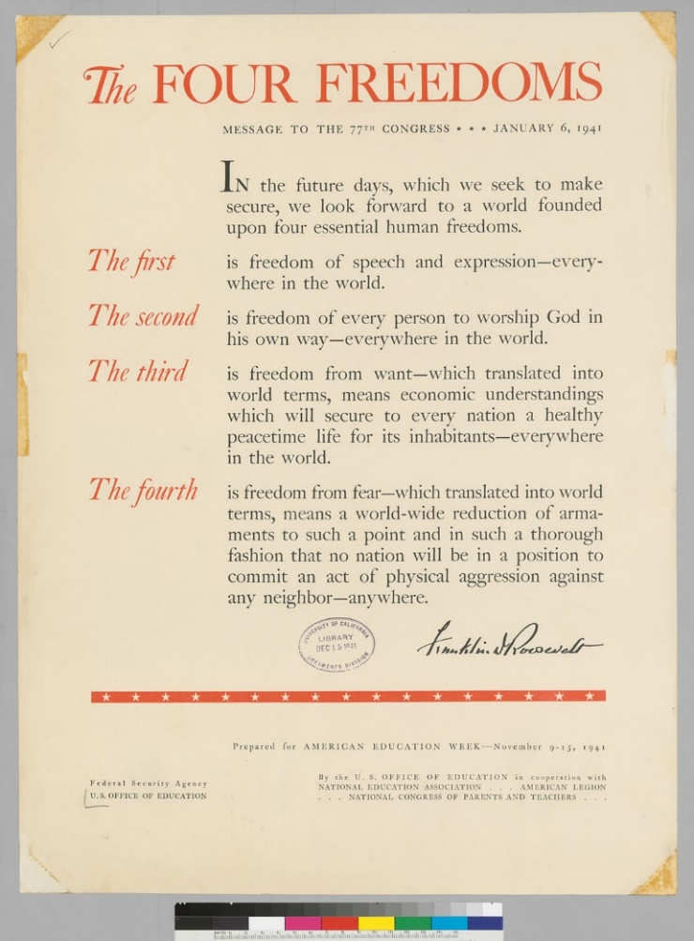
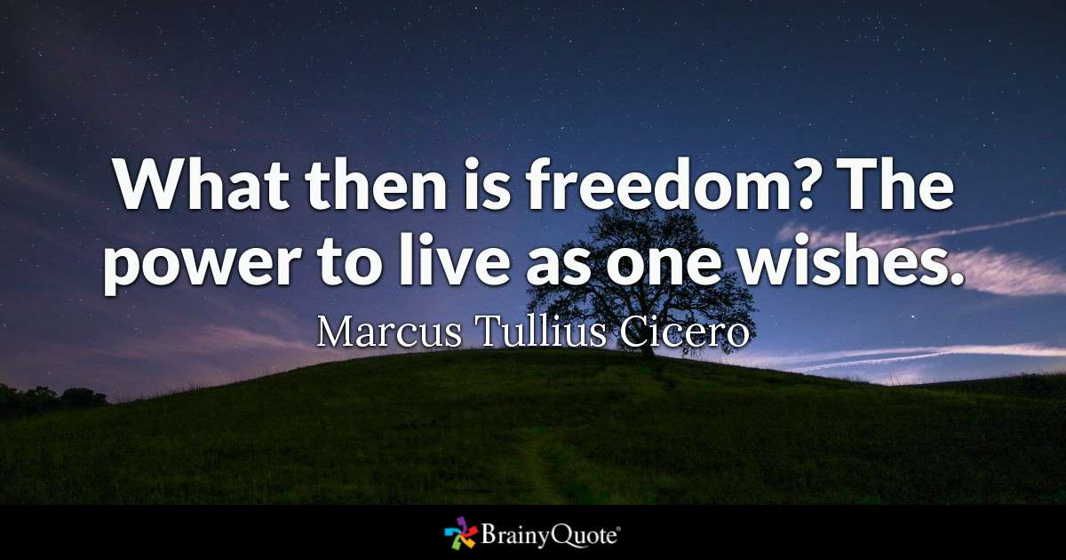
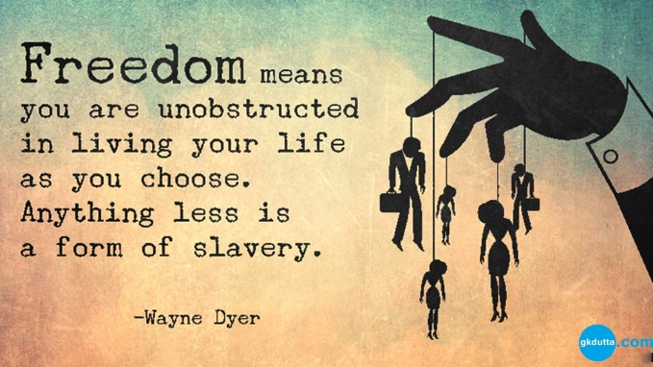
IIi. freedom
The absence of constraints on the individual
FDR’s Four Freedoms: of speech and worship, from want and fear
John Stuart Mill (p.96): Maximum freedom of thought yields the greatest progress and happiness
Notes:
John mill: said the harm principal stuff (next slide)

Slide 6
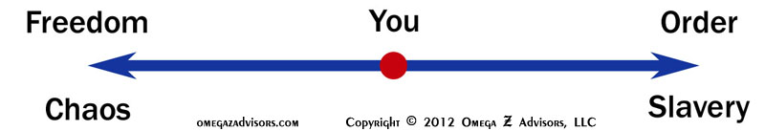
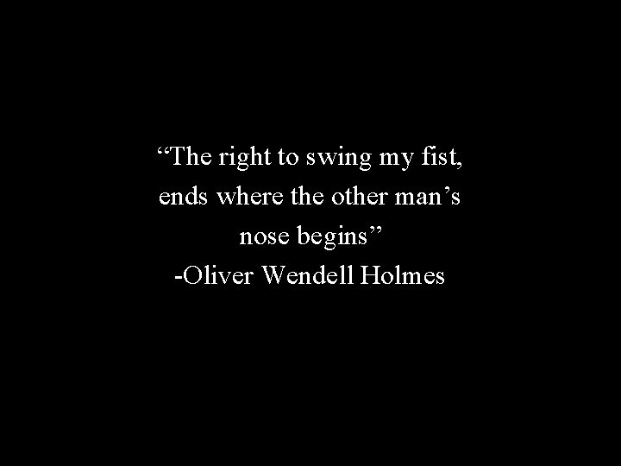

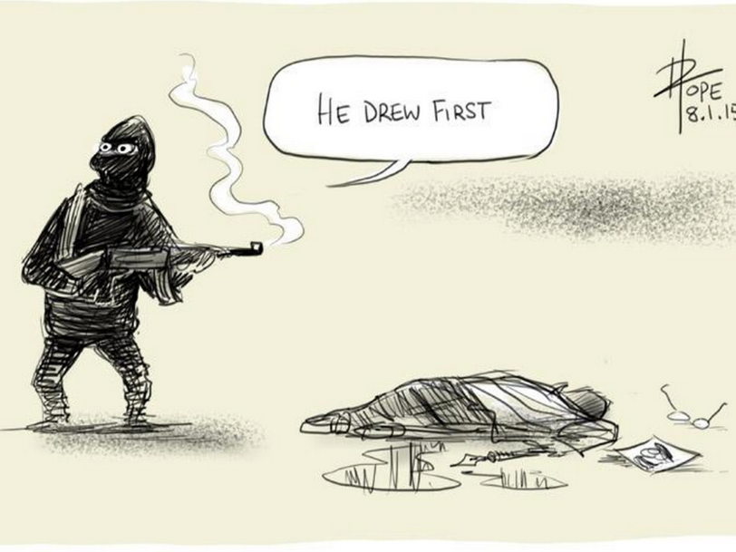
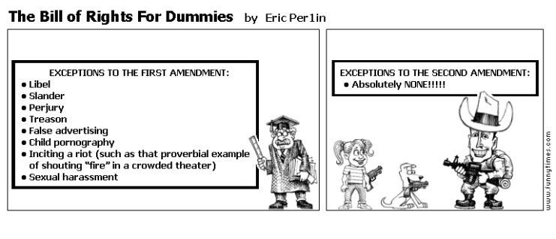
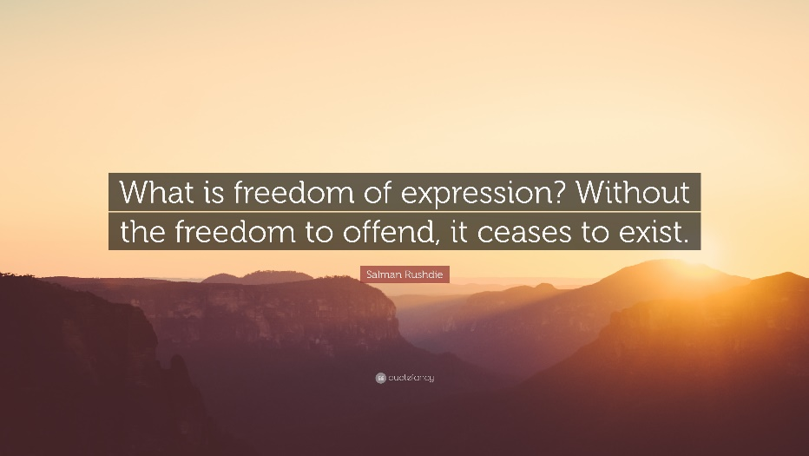
LIMITS OF freedom?
Harm Principle: only actions that cause physical or financial harm should be limited, not merely offensive (Mill)
Speech & Harm
Libel and Slander
Yelling “Fire” in a Theater
Offensiveness, “Cancel Culture” & Respect
https://funnytimes.com/54309/
Notes:
Charlie Hebdo is an offensive, political French publication

Slide 7
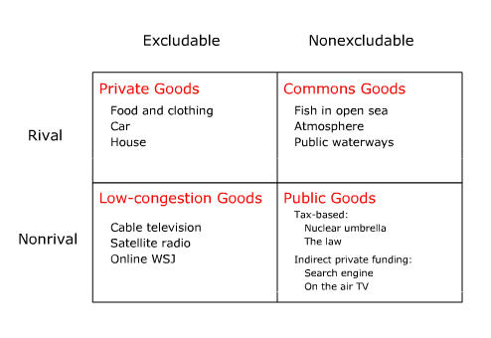
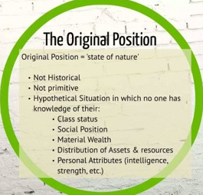

IV. Justice
Provision of public goods
non-excludable shared services & goods
Rawls’ Theory of Distributive Justice
Who gets what in the Original Position and the Veil of Ignorance
Justice and Freedom
is an individual “really free to develop as a human being and enjoy freedom if she does not have enough to eat or a roof over her head?”
Equality of opportunity v. outcome?
Notes:
Rawls, thought that everyone should be given their fair share if we pretended everyone was equal

Slide 8
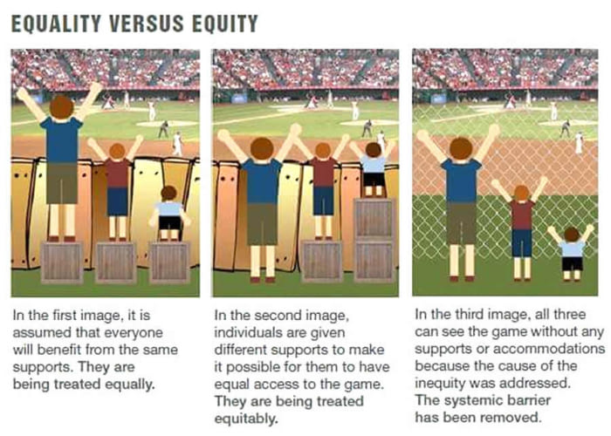
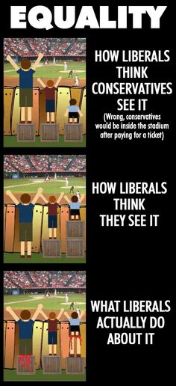
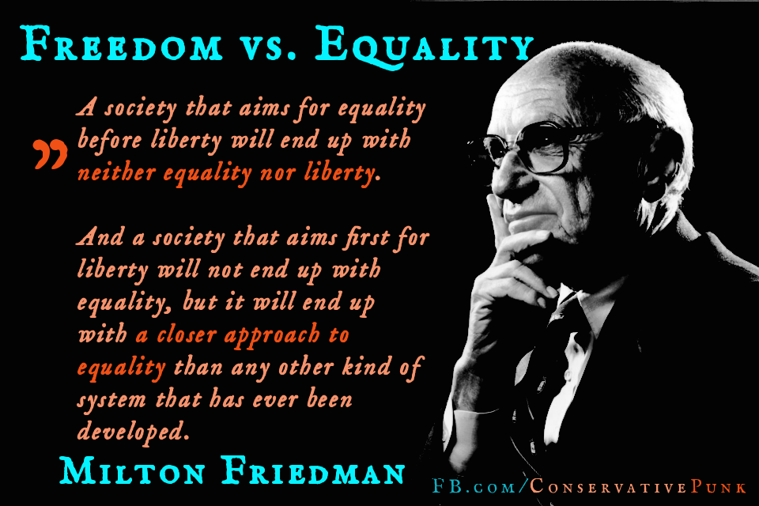
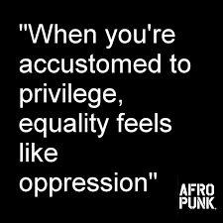
Equality, equity & justice
https://youthcommunityservice.org/supporting-social-justice/

Slide 9
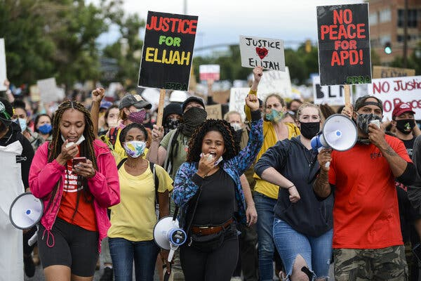
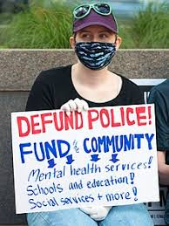
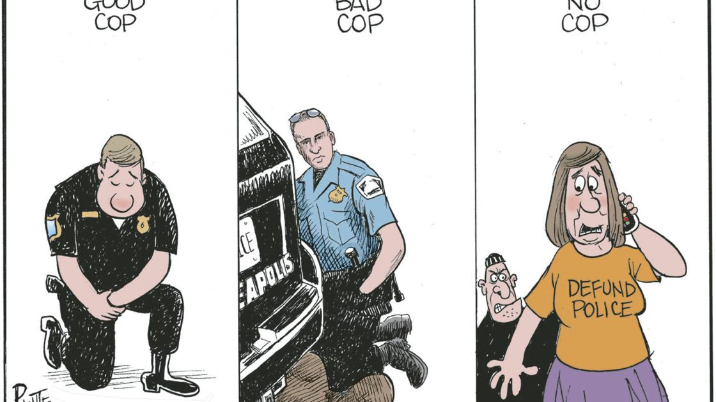
Justice and order: No justice, no peace?

